Slide 1
ANOMALY DETECTION

Slide 2
Contents
What is Anomaly Detection ?
Anomaly
Types of Anomalies
Common Anomaly Detection Methods
Challenges in Anomaly Detection
Latest Trends in Anomaly Detection
Case Study

Slide 3
What is Anomaly Detection ?
Anomalies are data points that stand out from other data points in the data set and don’t conform to the normal behavior in the data.
Statistically, anomalies are often identified when the data points deviate significantly from the mean in a dataset that follows a Gaussian (normal) distribution, typically by being more than a set number of standard deviations away from that mean.
Anomaly detection is an unsupervised data processing technique to detect anomalies from the data set. It examines specific data points and detects rare occurrences that seem suspicious because they’re different from the established pattern of behaviors.
Anomaly detection is fundamental in many applications, most notably in real-time applications, where spotting anomalies is vital such as in healthcare, finance and banking, cybersecurity applications, environmental monitoring, etc.

Slide 4
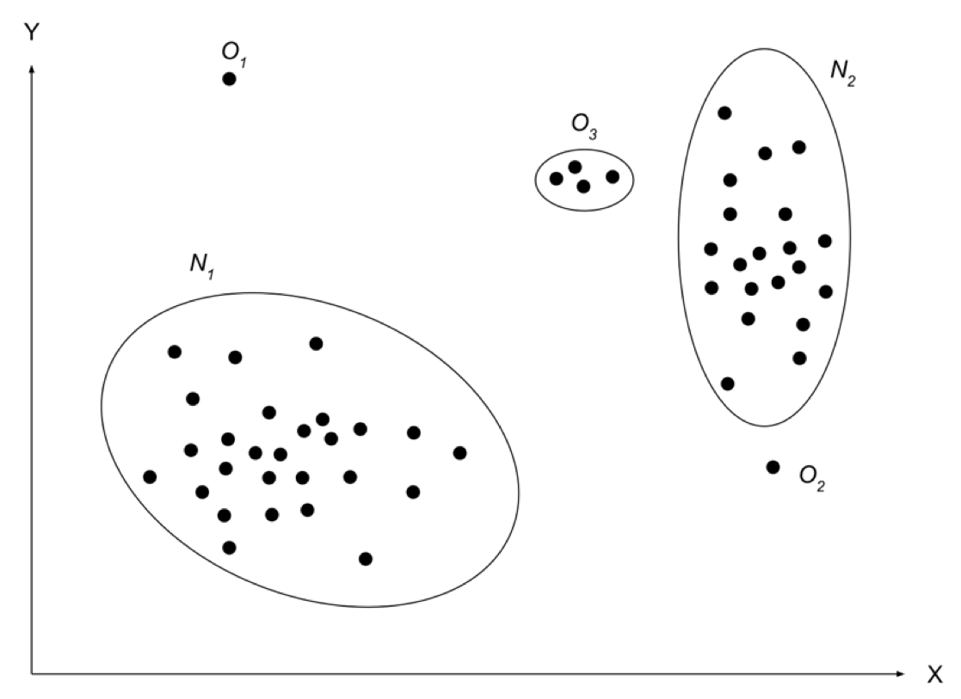
Anomaly
Anomalies are patterns in the data that do not conform to a well-defined notion of normal behaviour.
Anomalies, if left undetected, can give rise to a cascade of detrimental consequences, such as:
Operational Disruptions
Financial Losses
Cyber Security threats
Process Optimization

Slide 5
Types of Anomalies
Point Anomalies
Collective Anomalies
Contextual Anomalies
Single data point stands out from the expected pattern, norm or range.
A set of data points are anomalous when compared with the whole set.
Anomalies which are anomalous in certain contexts but not in another
1
2
3

Slide 6
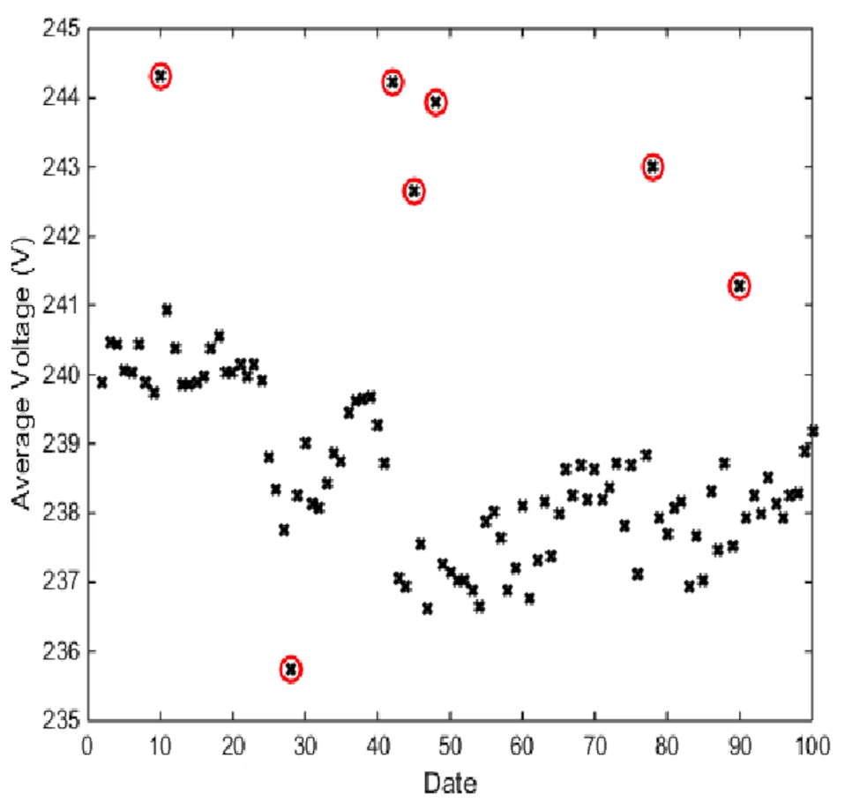
Point Anomaly
Point anomalies are isolated data points that do not follow to the overall distribution of the data.
Identifying point anomalies typically involves comparing the value of each data point to a measure of central tendency and spread, such as the mean and standard deviation, or using statistical techniques that model the data distribution.
These are the simplest and most easily identifiable type of anomaly, as you can see from the image below.

Slide 7
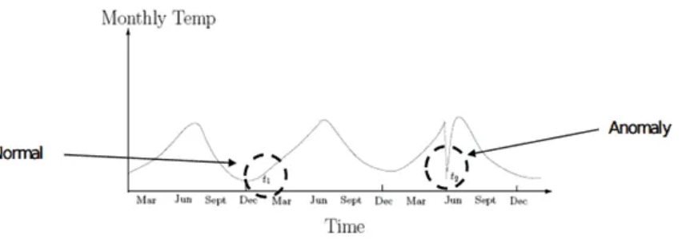
Contextual Anomaly
A contextual anomaly is a data point that significantly differs from the rest of the data points in the same context. A data point that appears to be abnormal in one context may not be abnormal in another.
This type of anomaly is defined in terms of the conditions or environment in which it occurs and is often identified by considering the data within its specific context or environment.
This process is particularly relevant in fields like data analysis, machine learning, and statistics.

Slide 8
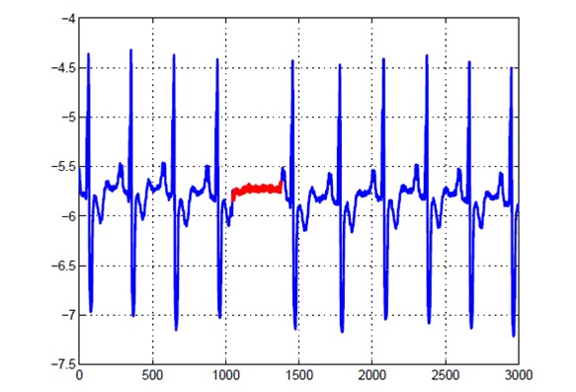
Collective Anomaly
A collective anomaly refers to a situation where a collection of related data points is anomalous compared to the entire data set, even though the individual data points within the collection may not be anomalies themselves.
Detecting collective anomalies involves understanding the interrelationships between data points and recognizing when a group of them deviates from the norm.
This concept is particularly significant in fields like data analysis, network security, and environmental studies.
An irregular heart beat

Slide 9
Common Anomaly Detection Methods
There are several types of anomaly detection methods, each suitable for different scenarios and types of data:
Inter Quartile Range (IQR)
Local Outlier Factor (LOF)
Isolation Forest
LSTM Anomaly Detection
k-Means Anomaly Detection
Principal Component Analysis (PCA)

Slide 10
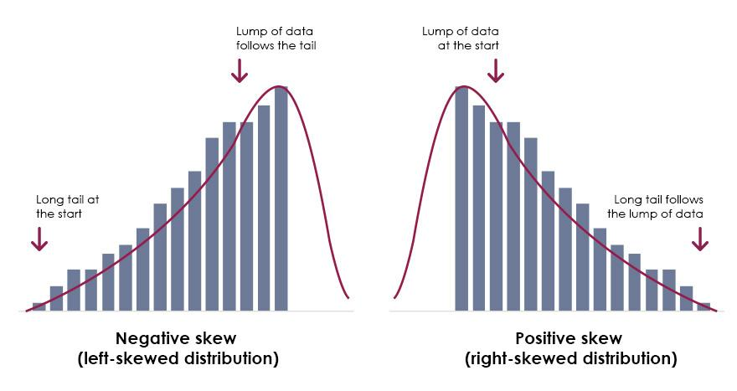
Inter Quartile Range (IQR)
IQR Method is best suited when the data forms a skewed distribution.
IQR measures variability by dividing the dataset into four equal quartiles. First, the entire data is to be sorted in ascending order, and then splitting it into four equal quartiles called Q1, Q2, Q3, and Q4, which can be calculated using the following equation:
The first Quartile (Q1) divides the smallest 25% of the values from the other 75% that are larger.
Q1 = (n+1)/4 Ranked Value (25th Percentile)
The Third quantile (Q3) divides the smallest 75% of the values from the largest 25%.
Q3 = 3(n+1)/4 Ranked Value (75th Percentile)

Slide 11
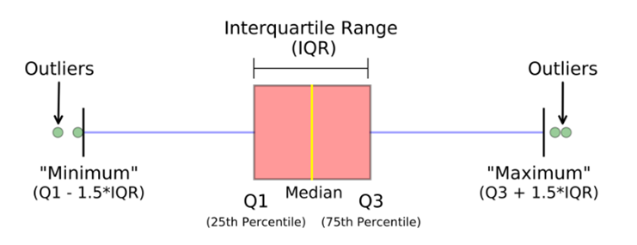
IQR (Inter Quantile Range) = Q3– Q1
Lower Bound Limit = Q1 – 1.5 x IQR
Upper Bound Limit = Q3 + 1.5 x IQR
So Anomalies can be considered any values which are greater than Upper Bound Limit (Q3+1.5*IQR) and less than Lower Bound Limit (Q1-1.5*IQR) in the given dataset.

Slide 12
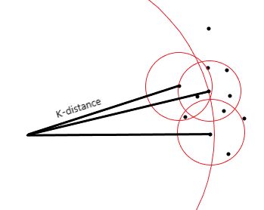
Local Outlier Factor (LOF)
The Local Outlier Factor (LOF) is an unsupervised anomaly detection algorithm that assesses the local density deviation of a data point compared to its neighbors. It identifies outliers by examining if a point has significantly lower density than its neighbors, indicating an anomalous local density deviation. The algorithm calculates the ratio of neighbor density to point density, and a higher LOF suggests a higher likelihood of the point being an outlier.
Now to compute the density of a point we define the K-distance of a point. This is intuitively the distance of the Kth nearest neighbour to the point.
K-distance(A)= Dist(A, Kth nearest neighbour)
The K neighbourhood of a point is just the K closest points to a given point.
Nk(A) = { P | Dist(A,P)<= K-distance(A)}

Slide 13
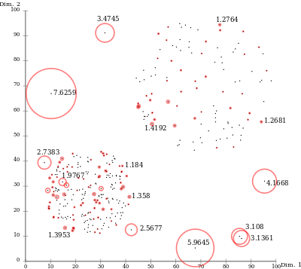
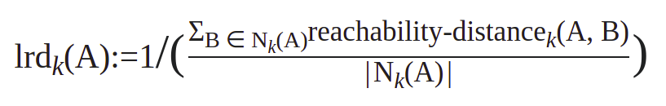
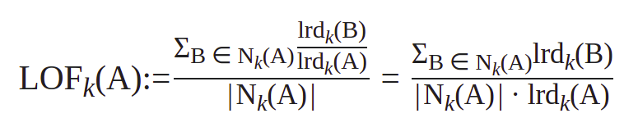
The reachability distance defines how easy it is to reach a point from another point. If a point A is in the K-neighbourhood of B then it is easier to reach A and the reachability distance is lower. For a point A that is not in the K-neighbourhood of B, the reachability distance is higher.
Reachability Distancek(A,B)= max{ k-distance(B), dist(A,B) }
The local reachability density is defined as the reciprocal of the average reachability distance of points around A to A:
The local reachability factor is the average ratio of densities of neighbouring points of A to A:
.
LOF ≈1 ⇒ no outlier
LOF ≫1 ⇒ outlier

Slide 14
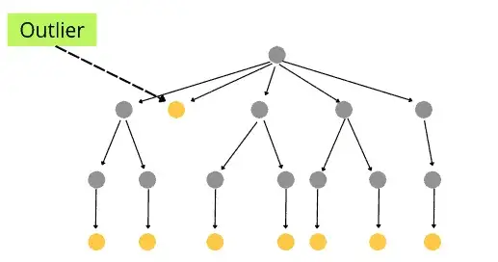
Isolation Forest
The isolation forest algorithm detects anomalies using a tree-based approach. It is based on modelling normal data in order to isolate anomalies that are both few in number and distinct in the feature space. The algorithm essentially accomplishes this by generating a random forest in which decision trees are grown at random; at each node, features are chosen at random, and a random threshold value is chosen to divide the dataset in half.
It keeps cutting away at the dataset until all instances are isolated from one another. Because an anomaly is usually far away from other instances, it becomes isolated in fewer steps than normal instances on average (across all decision trees).

Slide 15
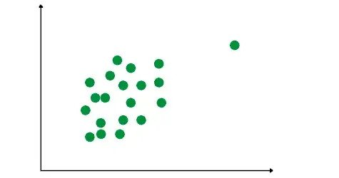
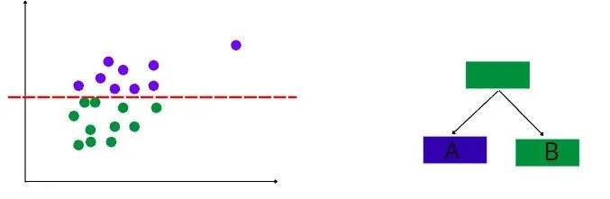
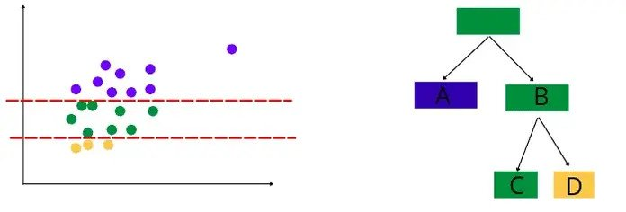
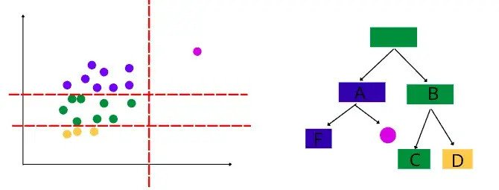
Let’s say we have the following data point:
The algorithm will start building binary decision trees by randomly splitting the dataset.
After that, the algorithm will split the data randomly and continue building the decision tree.
The same process of a random split will continue until all the data points are separated.

Slide 16

The algorithm takes three splits to isolate the above point. but if it continues, isolating other points nearby becomes more time-consuming due to increased iterations. A lower average split count indicates a higher likelihood of a data point being an outlier. The efficiency comes from fewer splits needed for isolated points, making it quicker to identify potential anomalies.
After isolating all the data points, the algorithm uses the following equation to detect anomalies:
n – is the number of external nodes
h(x) – is the path length of observation x
c(n) – is the average path length of an unsuccessful search in a binary tree
So, the above equation will give each observation an anomaly score. If the anomaly score is close to 1, the point is considered to be an outlier. If the score is smaller than 0.5, then observation is considered to be normal. If all the scores are close to 0.5, the entire dataset does not have clear anomalies.

Slide 17
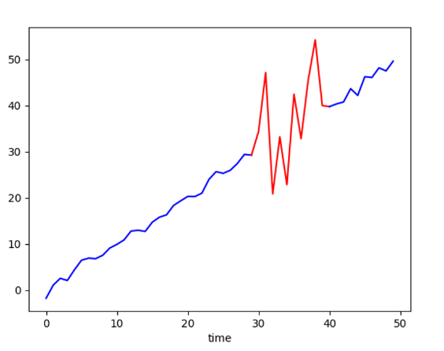
LSTM Anomaly Detection
LSTM is a neural network that can be applied to detect contextual anomalies in time-series.
We attempt to train a model which is able to predict future values in the time series. The intuition behind this approach is that the usual quasi-periodic patterns in the time series should be predictable with only small errors, while abnormal behavior should lead to large deviations in the predictions.

Slide 18
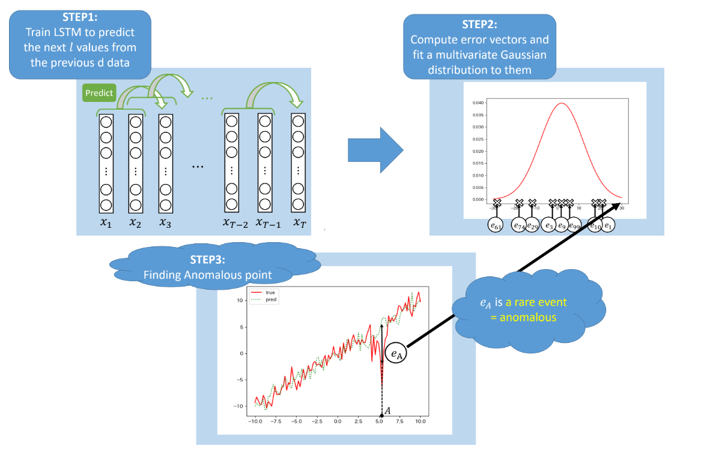

Slide 19
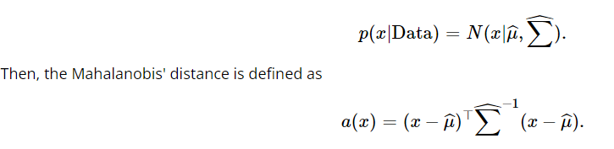
Mahalanobis' Distance:
We can measure the rarity of the event with the location in the distribution. The Mahalanobis' distance is a statistical measure, representing an anomaly score. Assuming the parameters of an M dimensional Gaussian distribution are estimated as follows.
We can measure the rarity of the event with a(x).
For most data points in the time series, the corresponding Mahalanobis distance will be comparably small, since they are located close to the mean of the distribution. On the other hand, unusual patterns in the error vectors e_{i} – such as large errors in one or more dimensions – will result in large values in the Mahalanobis distance.

Slide 20
k-Means Anomaly Detection
k-Means is an unsupervised learning algorithm used for clustering problems whereas KNN is a supervised learning algorithm used for classification and regression problems.
What is k-Means clustering?
In the context of anomaly detection, the algorithm is used to identify data points that do not belong to any cluster or have high distances from the cluster centroid. These data points are considered anomalies because they deviate from the norm. This method can be used to identify point and collective anomalies.

Slide 21
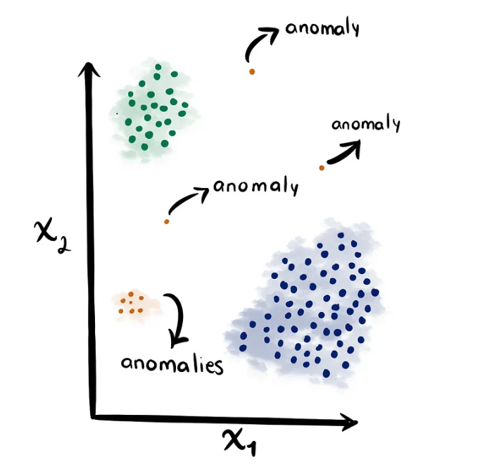
Algorithm
Step 1: Select k random instances from the training data subset as the centroids of the clusters C1; C2;...Ck.
Step 2: For each training instance X:
a. Compute the Euclidean distance D(Ci,X),i = 1...k
b. Find cluster Cq that is closest to X.
c. Assign X to Cq. Update the centroid of Cq (The centroid of a cluster is the arithmetic mean of the instances in the cluster.)
Step 3: Repeat Step 2 until the centroids of clusters C1; C2; ...Ck stabilize in terms of mean-squared-error criterion.
Step 4: For each test instance Z:
a. Compute the Euclidean distance D(Ci,Z),i = 1...k. Find cluster Cr that is closest to Z.
b. Classify Z as an anomaly or a normal instance using the Decision tree.
If a particular cluster significantly differs from other clusters, the objects in this cluster might be outliers.

Slide 22
The idea behind this approach is that the data points that deviate from the norm will be farther away from the cluster centroid, making them easier to identify as anomalies. The number of clusters, k, should be chosen carefully, as it has a direct impact on the performance of the algorithm.
Advantages:
It is simple, and easy to interpret.
High scalability since most of calculations can be run in parallel.
Disadvantages:
The outliers can skew the centroids of clusters.
Poor performance in high dimensional data.
k-Means clustering is based on Euclidean distance, which may not always be the most appropriate measure of similarity for all types of data.

Slide 23
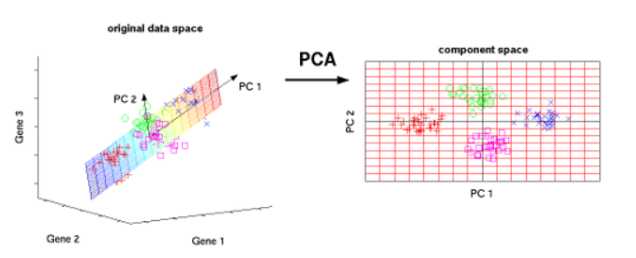
Principal Component Analysis
Principal component analysis (PCA) is a multivariate technique that analyzes a dataset in which observations are described by several inter-correlated quantitative variables.
Briefly, the idea is to break the source data matrix down into its principal components, then map the original data into a new low-dimensional space by constructing a new feature space. PCA can improve the computing performance of data and alleviate the “Curse of Dimensionality”.

Slide 24
Step 1: n correlated random variables are transformed into d ≤ n uncorrelated variables.
The first principal component of the transformation is the linear combination of the original variables with the largest variance. The second principal component is the linear combination of the original variables with the second largest variance and orthogonal to the first principal component, and so on. In many data sets, the first several principal components contribute most of the variance in the original data set, so that the rest can be disregarded with minimal loss of the variance for dimension reduction of the dataset.
Step 2: Reconstruct the original data using just the first few principal components. The reconstructed data will be similar to, but not exactly the same as, the original data.
Step 3: The reconstructed data points that are the most different from the corresponding original points are anomalies.

Slide 25
Advantages:
Dimensionality reduction
Noise Reduction
Complementary to other methods
Disadvantages
Assumption of gaussian distribution
Linear assumption
Sensitivity to outliers
Difficult to interpret

Slide 26
Challenges of anomaly detection
The ever-increasing scale and complexity of network and enterprise systems.
Often, anomalies are the result of malicious activity, and therefore sophisticated adversaries aim to make the anomalous observations appear rather normal, thus making the task of defining normal behavior more difficult.
Many anomaly detection techniques require labeled data, but in fast-evolving dynamic environments, the latter becomes costly to acquire.
Nonparametric techniques pose challenges, including computational ones and possible lack of adequate detection power.
Anomaly detection algorithms must operate in a privacy-preserving manner.
Achieving real-time detection poses challenges due to the computational complexity.
Balancing accuracy and interpretability becomes crucial, especially in applications requiring explainability.
Continuous model updating and adaptation are necessary to cope with concept drift and ensure the detection of evolving anomalies.

Slide 27
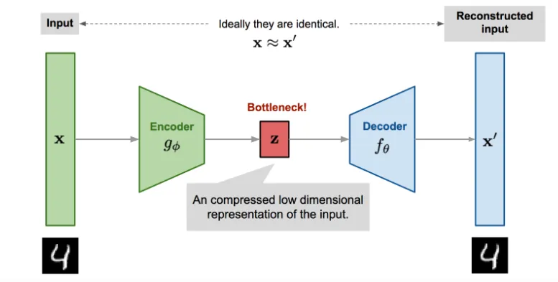
Auto Encoders
Autoencoders are powerful generative unsupervised deep learning algorithms
Neural Network Structure:
Consists of an encoder and a decoder.
Encoder compresses input data into a lower-dimensional representation.
Decoder reconstructs the input data from the compressed representation.
Bottleneck Layer:
Bottleneck layer in the middle contains the latent representation of the input data.
Size of the latent space is a critical parameter influencing the trade-off between compression and information retention.

Slide 28
During training, autoencoders aim to minimize the reconstruction error.
The loss function measures the disparity between the input data and its reconstructed output.
Anomalies are identified by evaluating the magnitude of the reconstruction loss.
Anomaly Detection Phase:
Once the autoencoder is trained on normal, non-anomalous data, it can be used for anomaly detection.
During the anomaly detection phase, the model takes in new, unseen data and tries to reconstruct it. If the input data is similar to what the model has seen during training, the reconstruction error should be low.
If the data contains anomalies or patterns that differ significantly from the training data, the reconstruction error will be high.
Instances with high reconstruction errors are flagged as potential anomalies. The idea is that the autoencoder has not seen similar patterns during training, and therefore, the reconstruction error is high for anomalous data.

Slide 29
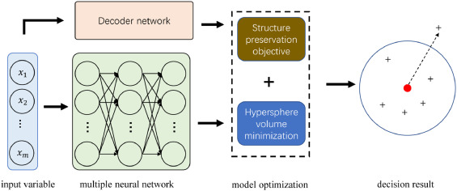
Deep SVDD
Deep SVDD (Support Vector Data Description) is a deep learning approach used for anomaly detection.
It combines the principles SVMs with deep neural networks to learn a compact representation of normal data and identify anomalies based on deviations from this learned representation.
It is a one-class learning method, meaning it is trained only on normal, non-anomalous data.
After training, the learned model is used for one-class classification. During testing or deployment, new data points are encoded using the trained encoder
The distance of a data point from the center of the learned representation is used as a measure of normality. Points close to the center are considered normal, while those farther away are potential anomalies

Slide 30
Case1:
Fraud Detection: Enron's Accounting Fraud Scandal
Background: In the early 2000s, Enron was embroiled in a massive accounting fraud scandal, which eventually led to its bankruptcy in 2001. The company was found to have manipulated its financial statements and concealed significant debt to maintain its stock price and secure loans
Anomaly Detection Role: In this case, anomaly detection was not used by Enron but rather by investigators and auditors. When suspicions of financial irregularities arose, forensic accountants and auditors employed anomaly detection techniques to identify unusual patterns and discrepancies in Enron's financial data
Impact: Enron's scandal resulted in one of the largest bankruptcies in U.S. history, affecting employees, shareholders, and investors. The case exposed the necessity of robust anomaly detection and regulatory oversight to prevent corporate fraud

Slide 31
Case 2 :
Fault Detection: NASA’s Mars Climate Orbiter
Background: In 1998, NASA's Mars Climate Orbiter was a spacecraft designed to study the Martian climate and atmosphere. However, a critical anomaly occurred during the mission that led to the loss of the spacecraft.
Anomaly Detection Role: The anomaly in this case was the result of a unit conversion error. Lockheed Martin, the contractor responsible for the orbiter's navigation system, used English units (pounds-force-seconds) instead of the metric system (newton-seconds) for a thruster performance-related parameter. The inconsistent units led to incorrect calculations, causing the orbiter to approach Mars at too low an altitude, ultimately disintegrating in the Martian atmosphere.
Impact: The loss of the Mars Climate Orbiter was a significant setback for NASA, both in terms of the mission's scientific objectives and the financial investment. It emphasized the need for robust anomaly detection and data validation procedures in space missions to prevent such costly errors.

Slide 32
Case 3 :
Cyber Security: Twitter’s Anomaly Detection for cyber security
Background: Twitter, like many technology companies, faces constant threats from cyberattacks, including Distributed Denial of Service (DDoS) attacks, hacking attempts, and fraudulent account activities. Ensuring the security and privacy of user data is a top priority.
Anomaly Detection Role: Twitter employs advanced anomaly detection techniques to monitor its network traffic and user interactions for any unusual patterns or malicious activities. These techniques involve statistical analysis of data, such as the volume and frequency of user interactions, in real-time.
Impact: Twitter's use of statistical anomaly detection has contributed to the platform's ability to maintain its security and integrity, safeguarding user data and maintaining trust in the platform.

